Slide 1
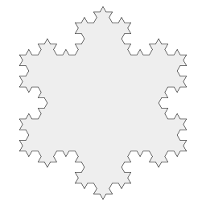
Iterator
Software Patterns

Slide 2
Intent
Provide a way to access the elements of an aggregate object sequentially without exposing its underlying representation.
An aggregate object is an object that contains other objects for the purpose of grouping those objects as a unit. It is also called a container or a collection. Examples are a linked list and a hash table.
Software Patterns
Notes:
Software Patterns

Slide 3
Also Known As
Cursor
Software Patterns

Slide 4
Motivation
An aggregate object such as a list should allow a way to traverse its elements without exposing its internal structure.
It should allow different traversal methods.
It should allow multiple traversals to be in progress concurrently.
But, we really do not want to add all these methods to the interface for the aggregate.
Software Patterns

Slide 5
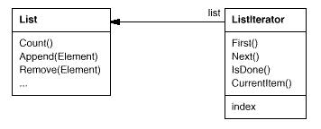
Iterator Example 1
Software Patterns

Slide 6
Iterator Example 1
List list = new List();
ListIterator iterator = new ListIterator(list);
iterator.First();
while (!iterator.IsDone()) {
Object item = iterator.CurrentItem();
// Code here to process item.
iterator.Next();
}
Software Patterns

Slide 7
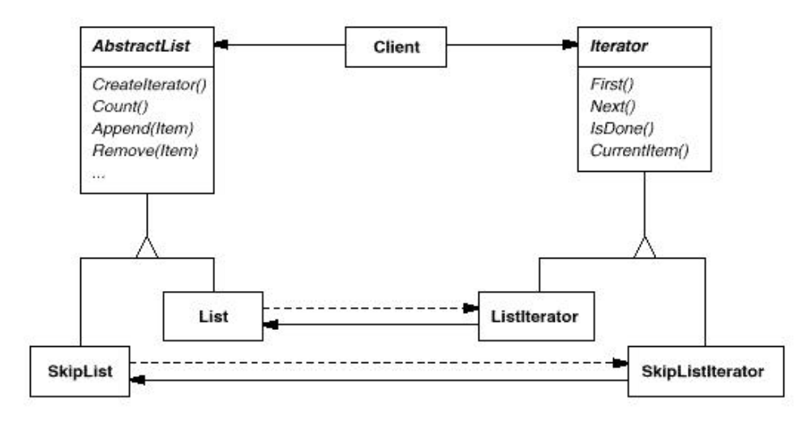
Iterator Example 2 – Polymorphic Iterator
Software Patterns

Slide 8
Iterator Example 2
List list = new List();
SkipList skipList = new SkipList();
Iterator listIterator = list.CreateIterator();
Iterator skipListIterator = skipList.CreateIterator();
handleList(listIterator);
handleList(skipListIterator);
...
public void handleList(Iterator iterator) {
iterator.First();
while (!iterator.IsDone()) {
Object item = iterator.CurrentItem();
// Code here to process item.
iterator.Next();
}
}
Software Patterns

Slide 9
Applicability
To support traversals of aggregate objects without exposing their internal representation.
To support multiple, concurrent traversals of aggregate objects.
To provide a uniform interface for traversing different aggregate structures (that is, to support polymorphic iteration)
Software Patterns

Slide 10
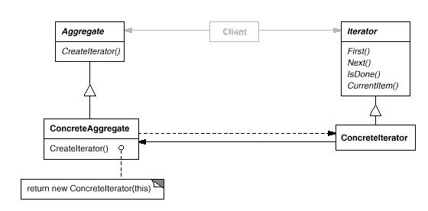
Structure
Software Patterns

Slide 11
Participants
Iterator
  Defines an interface for accessing and traversing elements
ConcreteIterator
  Implements the Iterator interface
  Keeps track of the current position in the traversal.
Aggregate
  Defines an interface for creating an Iterator object (a factory method!).
ConcreteAggregate
  Implements the Iterator creation interface to return an instance of the proper ConcreteIterator.
Software Patterns

Slide 12
Consequences
Benefits
  Simplifies the interface of the Aggregate by not polluting it with traversal methods.
  Supports multiple, concurrent traversals.
  Supports variant traversal techniques
Liabilities
  None!
Software Patterns

Slide 13
Implementation Issues
Who controls the iteration?
  The client => more flexible; called an external iterator
  The iterator itself => called an internal iterator
Who defines the traversal algorithm?
  The iterator => more common; easier to have variant traversal techniques
  The aggregate => iterator only keeps state of the iteration
Software Patterns

Slide 14
Implementation Issues
Can the aggregate be modified while a traversal is ongoing? An iterator that allows insertion and deletions without affecting the traversal and without making a copy of the aggregate is called a robust iterator.
Should we enhance the Iterator interface with additional operations, such as previous()?
Software Patterns

Slide 15
Related Patterns
Factory Method
  Polymorphic iterators use factory methods to instantiate the appropriate iterator subclass.
Composite
  Iterators are often used to recursively traverse composite structures.
Software Patterns

Slide 16
Real-time Example
/* Iterator interface has method declarations for iterating through TV channels. All remote controls implement Iterator. */
public interface Iterator {
public Channel nextChannel(int currentChannel);
public Channel prevChannel(int currentChannel);
}
Software Patterns

Slide 17
Real-time Example
/* ChannelSurfer is a part of remote control which implements the Iterator interface. This class overrides the nextChannel and prevChannel methods. */
public ChannelSurfer implements Iterator {
public Channel nextChannel (int currentChannel) {
Channel channel =new Channel(currentChannel+1);
return channel;
}
public Channel prevChannel (int currentChannel) {
Channel channel = new Channel(currentChannel-1);
return channel;
}
}
Software Patterns

Slide 18
Real-time Example
/* RemoteControl class is the actual remote control and it behaves and makes use of ChannelSurfer */
public class RemoteControl {
private ChannelSurfer surfer;
private Settings settings;
public RemoteControl() {
surfer = new ChannelSurfer();
settings = new Settings();
}
public getProgram(ChannelSurfer surfer) {
return new Program(surfer.nextChannel());
}
}
Software Patterns

Slide 19
Java Implementation Of Iterator
The java.util.Enumeration interface acts as the Iterator interface.
Aggregate classes that want to support iteration, provide methods that return a reference to an Enumeration object.
This Enumeration object implements the Enumeration interface and allows a client to traverse the aggregate object.
Java JDK 1.1 has a limited number of aggregate classes: Vector and Hashtable.
Java JDK 1.2 introduced a new Collections package with more aggregate classes, including sets, lists, maps and an Iterator interface.
Software Patterns

Slide 20
Enumeration Example
import java.util.*;
public class TestEnumeration {
public static void main(String args[]) {
Vector v = new Vector();
v.addElement(new Integer(5));
v.addElement(new Integer(9));
v.addElement(new String("Hi, There!"));
Enumeration ev = v.elements();
System.out.println(”\nVector values are:");
traverse(ev);
Software Patterns

Slide 21
Enumeration Example
Hashtable h = new Hashtable();
h.put("Bob", new Double(6.0));
h.put("Joe", new Double(18.5));
h.put("Fred", new Double(32.0));
Enumeration ekeys = h.keys();
System.out.println("\nHash keys are:");
traverse(ekeys);
Enumeration evalues = h.elements();
System.out.println("\nHash values are:");
traverse(evalues);
}
Software Patterns

Slide 22
Enumeration Example
private static void traverse(Enumeration e) {
while (e.hasMoreElements()) {
System.out.println(e.nextElement());
}
}
Software Patterns

Slide 23
Enumeration Example
Test program output
Vector values are:
5
9
Hi, There!
Hash keys are:
Joe
Fred
Bob
Hash values are:
18.5
32.0
6.0
Software Patterns

